Slide 1
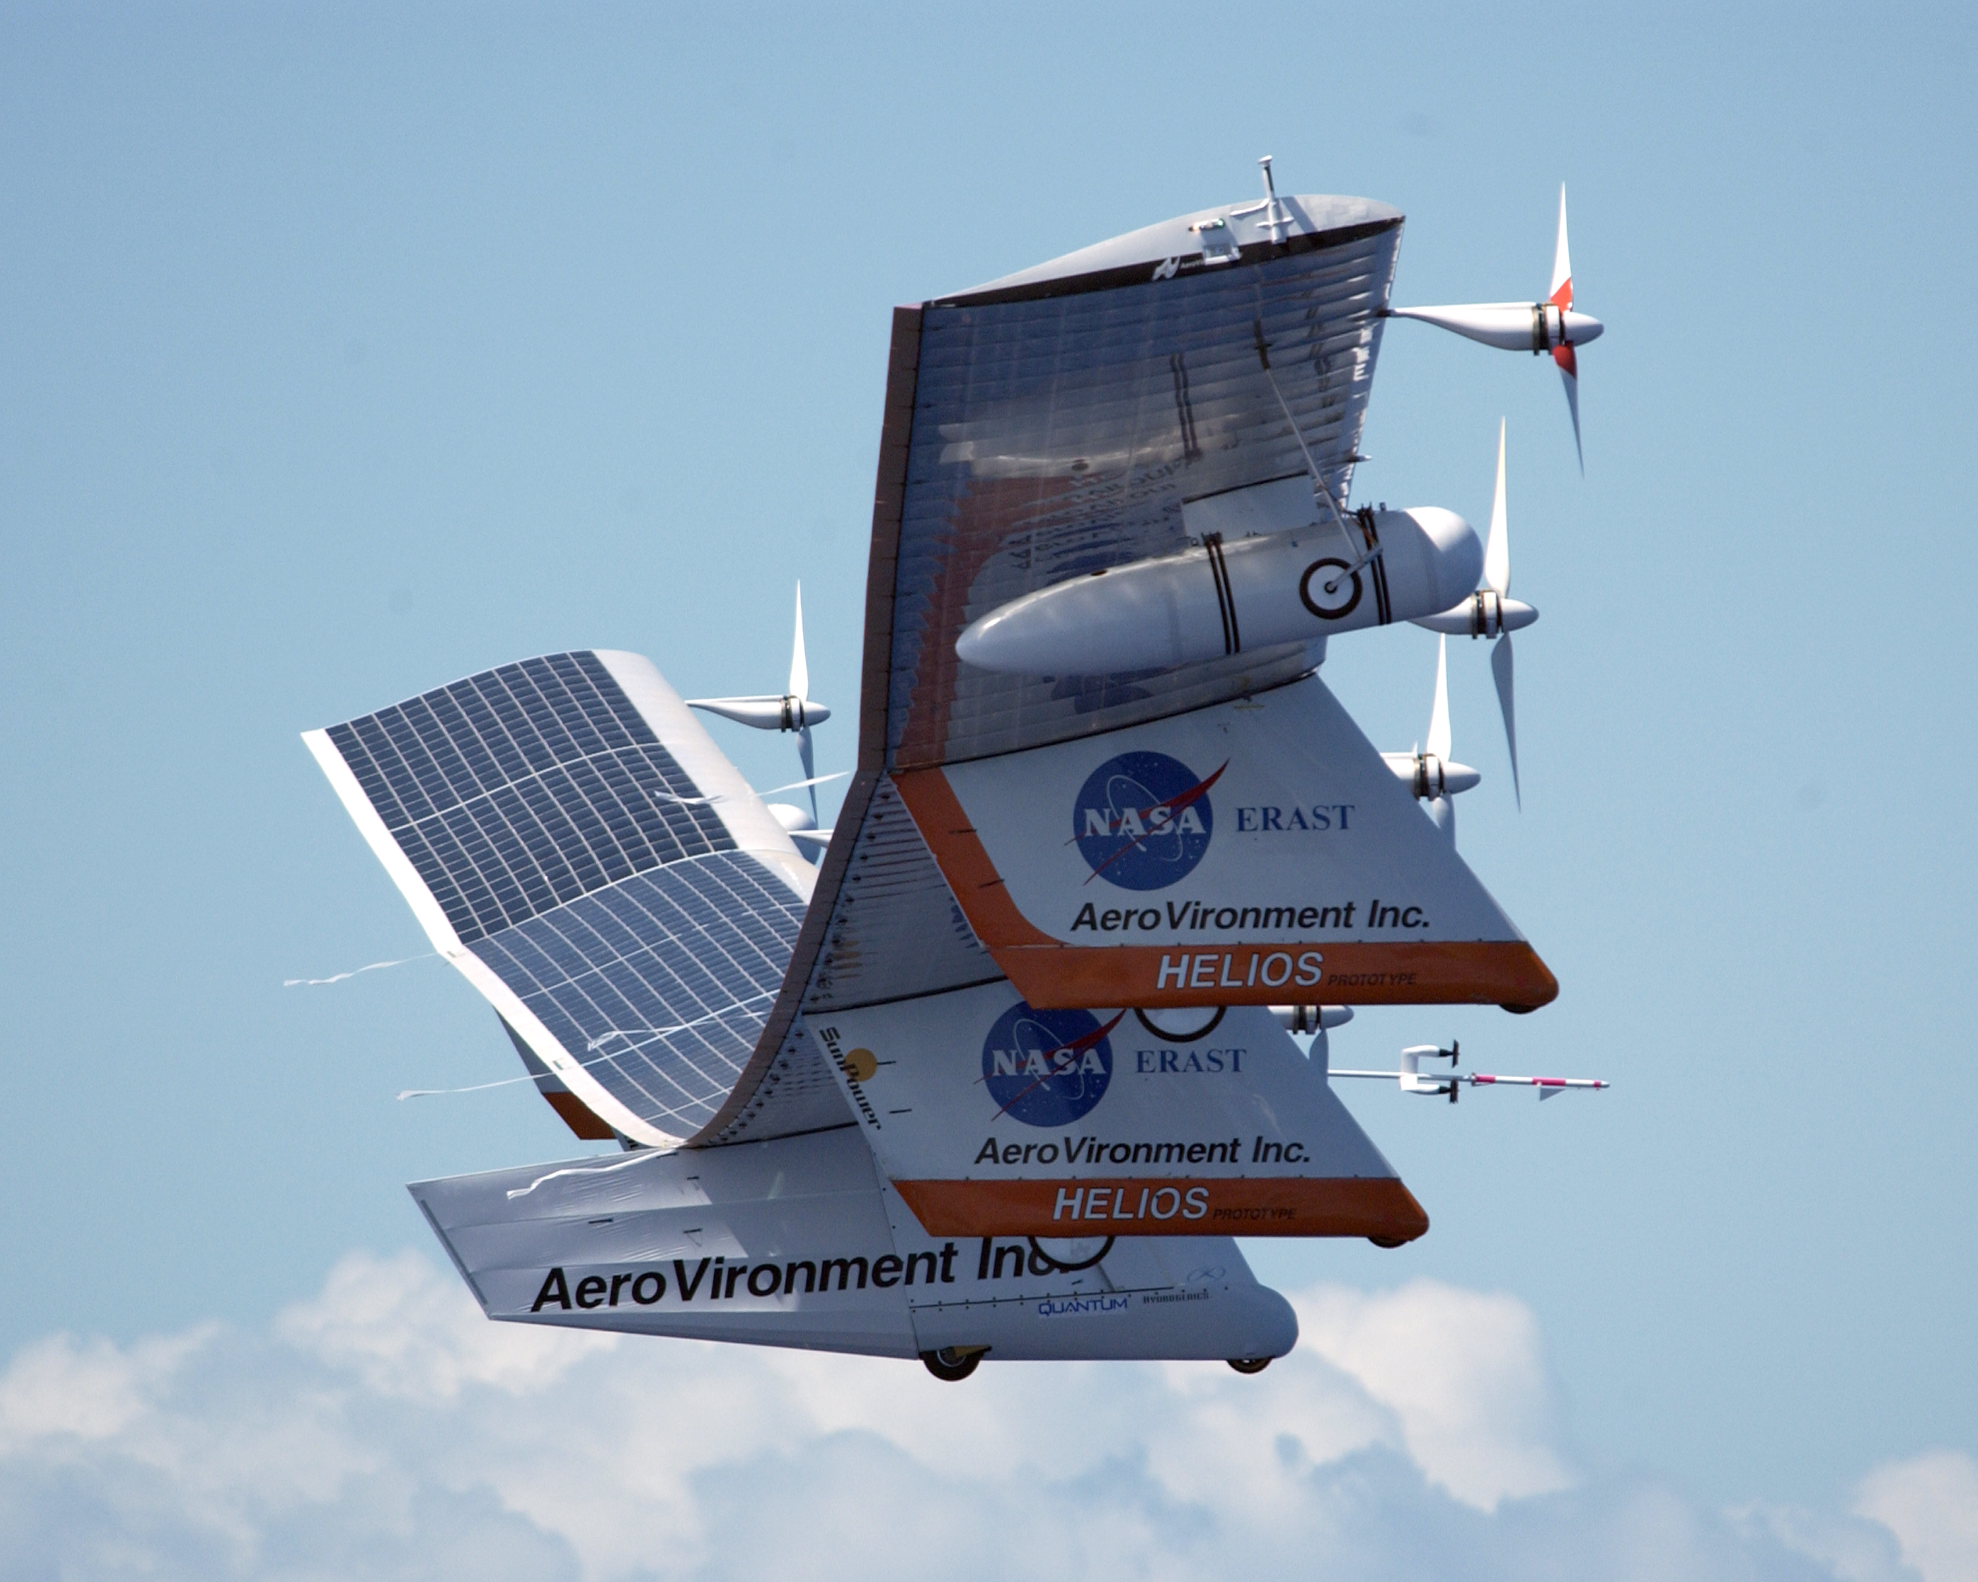
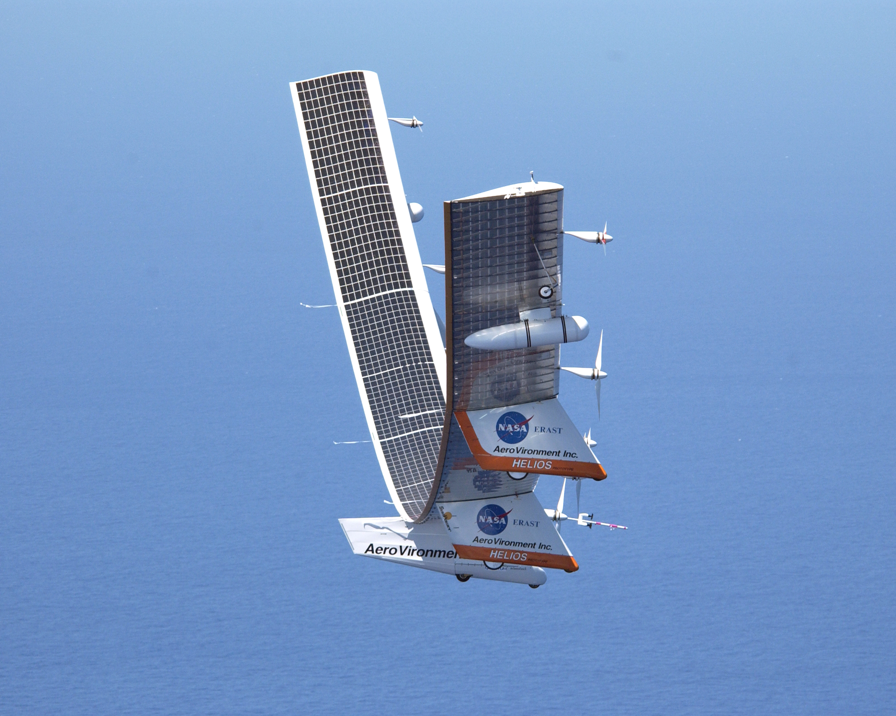
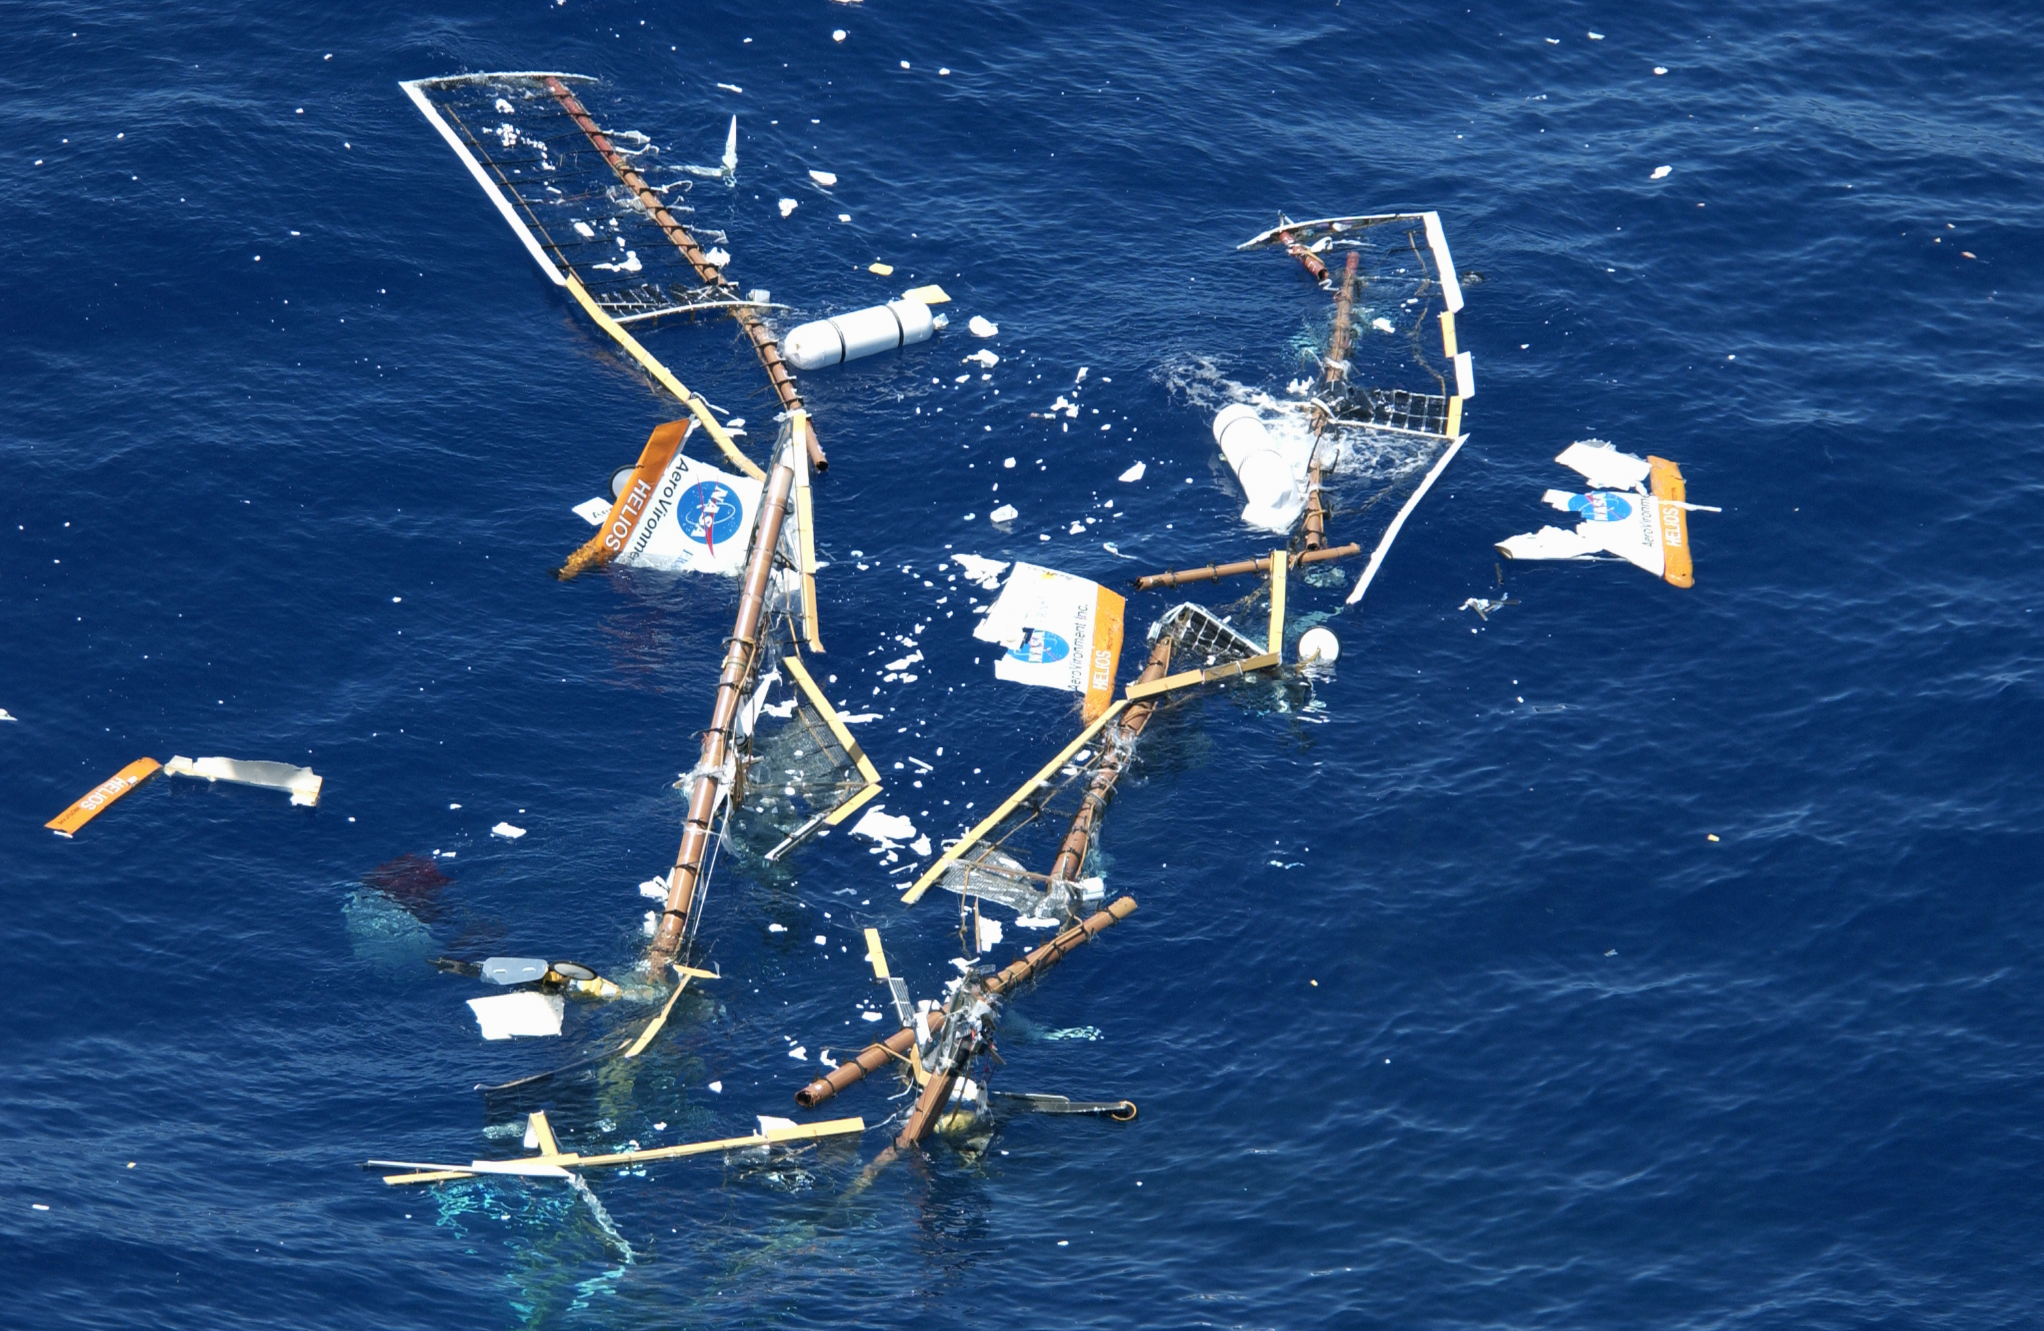
Bad things can happen when system interactions are not properly understood - Helios
This view of the Helios Prototype from a chase helicopter shows abnormally high wing dihedral (wingtips bending upward) of more than 30 feet from wingtip to the center of the aircraft that resulted after the Helios entered moderate air turbulence on its last test flight. The extreme dihedral caused aerodynamic instability that led to an uncontrollable series of pitch oscillations and overspeed conditions, resulting in structural failures and partial breakup of the aircraft.
Combined interaction among external environment, aerodynamics, flight controls and structure
Notes:
The Helios was an unmanned solar powered aircraft that set some amazing records for high altitude flight – over 80,000 feet in missions typically lasting over 214 hours. Onboard fuel cells charged from the solar cells during the day and powered the aircrafts propellers and other systems overnight.
Helios was named after the Greek God of the sun.
For more details : http://en.wikipedia.org/wiki/NASA_Pathfinder
Dihedral is the bend of the wings.
In order for this solar powered aircraft to work, it had to be extremely lightweight. This resulted in a highly flexible structure. despite the fact that it had several successful flights a fatal system interaction was resident in the system. When it entered a gust the wings bent resulting in a rapid descent as the wings lost lift. The flight control system caused the aircraft to pull up to slow down and maintain altitude. As the aircraft “zoomed up” the airspeed went down and the flight control system was not fast enough to stabilize the aircraft so it entered another dive. This oscillation doubled each cycle. As the aerodynamic load is proportional to the square of the airspeed, and the aircraft had very tight limits on load, it rapidly overloaded and tore itself apartment.

